Slide 1
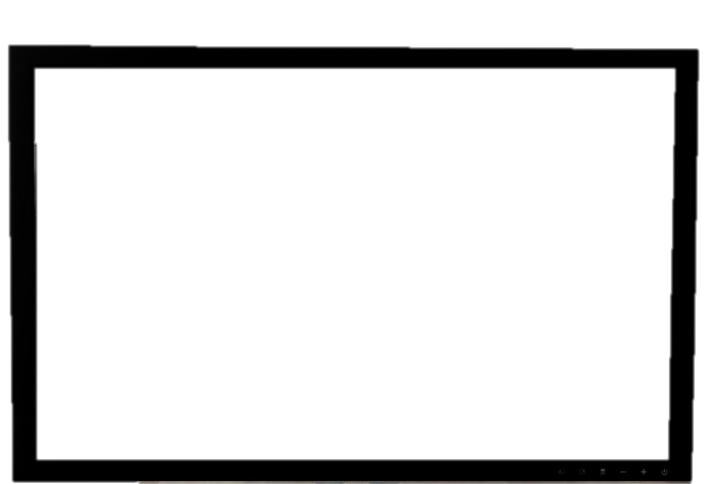
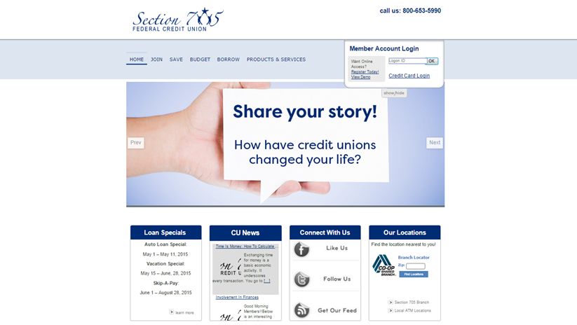
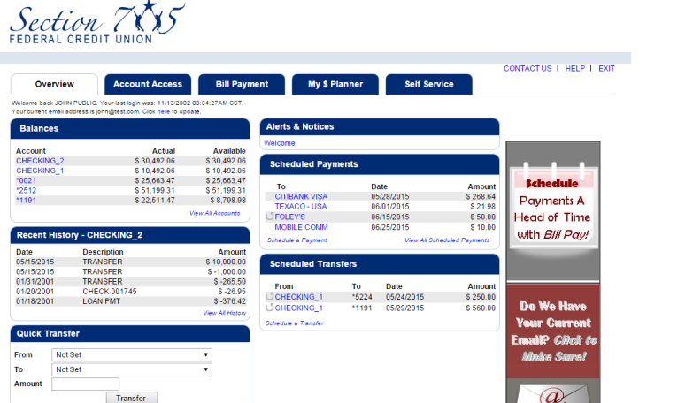
Check Out a Demo!
See if Online Banking is right for you.

Slide 2
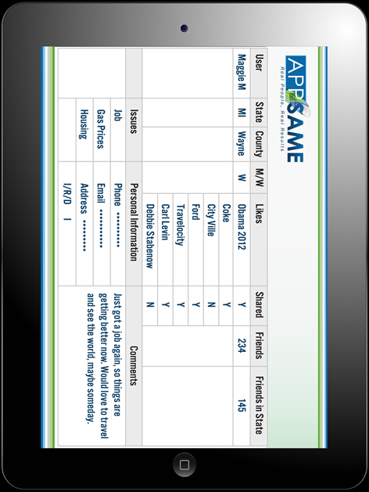
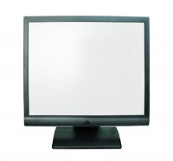
Why the New Look?
SIMPLE: Easier to find what you need.
MOBILE OPTIMIZED: Adjusts to the device you are using at the time.

